Slide 1
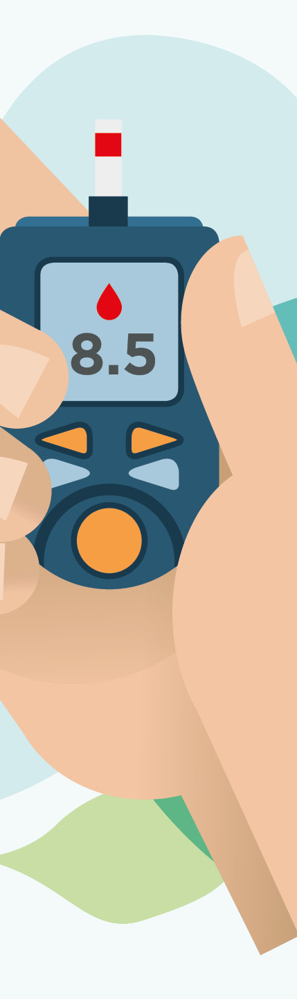
Predicting Diabetes using different Classification algorithms
By Ali A. Zamin

Slide 2

CONTENTS
Introduction
Abstract
Dataset Information
Data Preprocessing
Procedure and Tools
Modelling Techniques
Result
Conclusion
Reference

Slide 3
Introduction
Diabetes is a common chronic disease.
Diabetes can be identified when blood glucose is higher than normal, which is caused by higher secretion of insulin or biological effects.
Diabetes can cause various damage to body and cause disfunction tissues, kidneys, eyes and blood vessels.

Slide 4
Abstract
The motive of this project is to train different classification models on diabetes data and compare the performance of these models to see which classification technique performs better.
The performances of the classification algorithms will be evaluated using ROC-AUC and accuracy.
Experiment is performed on Pima Indians Diabetes Dataset (PIDD) which is acquired from Kaggle. However, originates from the National Institute of Diabetes and Digestive and Kidney Diseases.

Slide 5
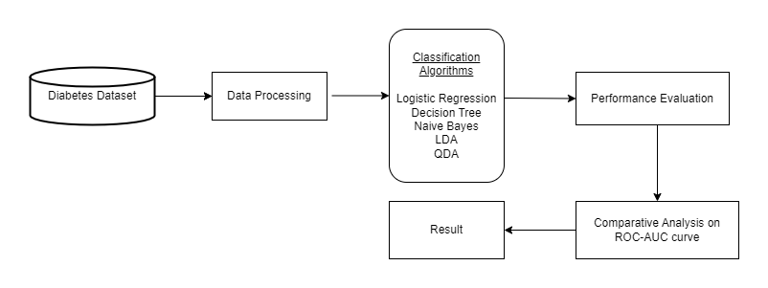
Design

Slide 6
Dataset Information
Diabetes dataset contains data samples from 768 patients (Females), including 8 input variables and 1 output variable.
Attribute | Description
1.Pregnancies | Number of times Pregnant
2.Glucose | Plasma Glucose Concentration
3.Blood Pressure | Diastolic Blood pressure(mmHg)
4.Skin Thickness | Triceps Skin fold Thickness(mm)
5.Insulin | 2-hour serum Insulin
6.BMI | Body Mass Index
7.Diabetes Pedigree Function | Indicates the function which scores likelihood of diabetes based on family history.
8.Age | Age(years)
9.Outcome | 1 indicates positive diabetes test. 0 indicates negative test

Slide 7
Data Pre-processing
Checked for null values.
Skin Thickness attribute contains a lot of zero values. Since It could affect the accuracy of our model, It is removed from the dataset.
Removed rows that contains zeros in features Glucose Blood Pressure, BMI, and Age, as they cannot have zero values.

Slide 8
Procedure and Tools
Jupyter Notebook
Splitting data for training and testing. 80% training and 20% testing.
Cross validation

Slide 9
Modelling Techniques
We used five classification algorithm for the data modelling.
1. Logistic Regression
2. Decision Tree
3. Naive Bayes
4. LDA
5. QDA

Slide 10

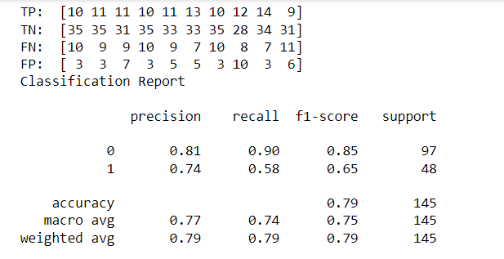
Logistic Regression

Slide 11
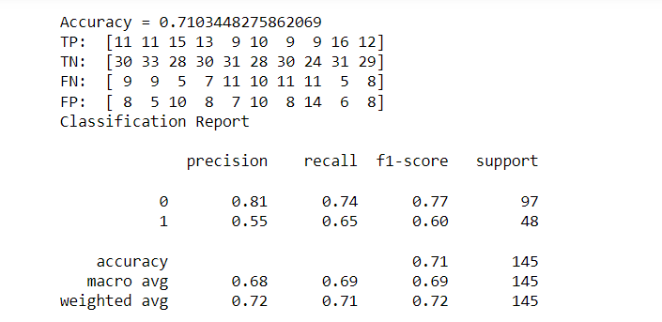
Decision Tree

Slide 12
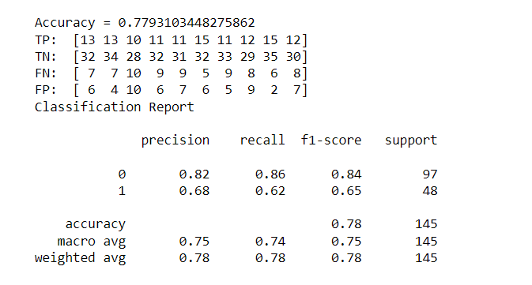
Naive Bayes algorithm

Slide 13
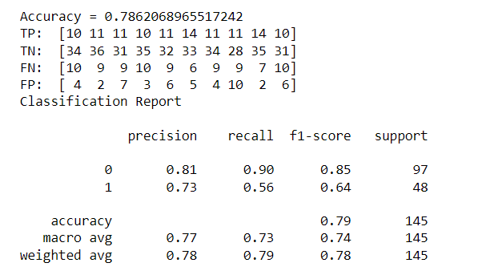
Linear Discriminant Analysis

Slide 14
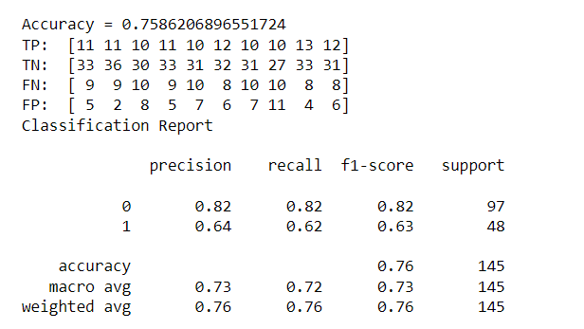
Quadratic Discriminant Analysis

Slide 15
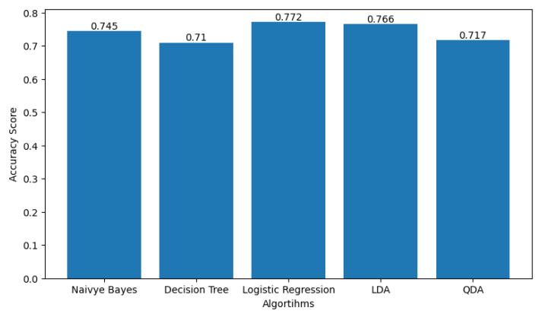
Result

Slide 16
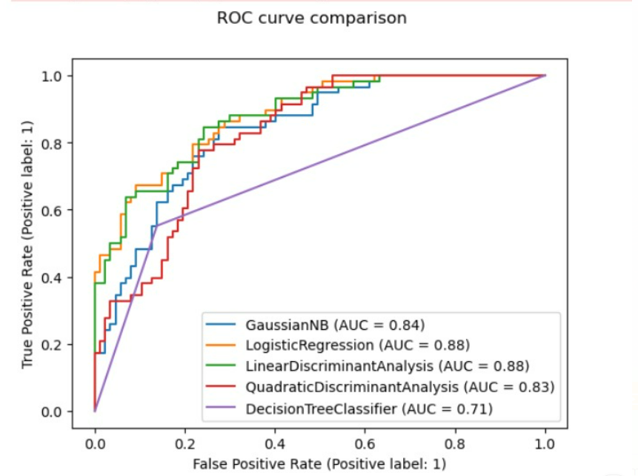
Result

Slide 17
ROC Curve is a performance measurement metric. Using ROC curve and AUC score, we can tell how much our model is capable of distinguishing between two classes (0 and 1). By analogy, the Higher the AUC, the better the model is at distinguishing patients whether they have diabetes or not.
Based on the AUC scores we got, Logistic Regression and Linear Discriminant Analysis turns out to have high AUC scores whereas Decision tree to have lowest AUC score.
This result suggests that, compared to other models, Logistic Regression and Linear Discriminant Analysis models perform best for predicting whether a patient has diabetes or not.

Slide 18
Conclusion
In this project, we presented our approach in the design and development of a diabetes prediction model and their performance evaluation.
As a result, we found out Logistic Regression and Linear Discriminant Analysis as best models in performing prediction of patients with diabetes and no diabetes, given the data.
Providing patients data to this models, it can predict with above 80% accuracy.
Model performance can further preform better if more data is provided.

Slide 19
References
https://www.kaggle.com/code/baturalpsert/diabetes-classification-roc-curve/notebook#ROC-Curve
https://www.kaggle.com/code/baturalpsert/diabetes-classification-roc-curve/notebook
https://www.youtube.com/watch?v=O_5kf_Kb684
https://scikit-learn.org
https://prezi.com/p/ezef9wri0ymy/predictive-analytics-in-healthcare-for-diabetes-prediction/?frame=386d1a205382fd219761ce7d9cbf26afa1129a37

Slide 20
THANK YOU

